Slide 1


INNOVACT 2025
INTERNET OF THINGS(IOT)
A self-emptying smart dustbin that opens for you, empties itself, and returns home.
TEAM DUSTWIN
REET SHRIVASTAV(24BCE2241)
AKSHAT JONATHAN FERNANDES(24BCE0284)
GEETIKA RUPANI(24BIT0058)
PRANSHI GUPTA(24BCE2268)
PRATYUSH TAYAL(24BCE0583)
Yukti ID- IR2025-995938

Slide 2
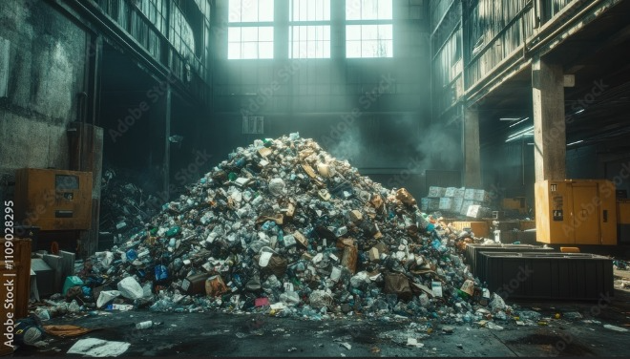
PROBLEM STATEMENT
Modern waste management struggles with hygiene, efficiency, and sustainability. Manual handling of bins increases the risk of germ transmission, especially in hospitals, schools, offices, and public spaces. Unnoticed overflows cause odors, pests, and health hazards, while fixed-schedule collection leads to wasted labor, higher costs, and poor efficiency. With urbanization expected to reach 68% of the global population by 2050 (UN), and improper waste linked by the WHO to disease spread, the demand for touchless, intelligent, and efficient waste solutions has become more urgent, especially in the post-COVID era.

Slide 3
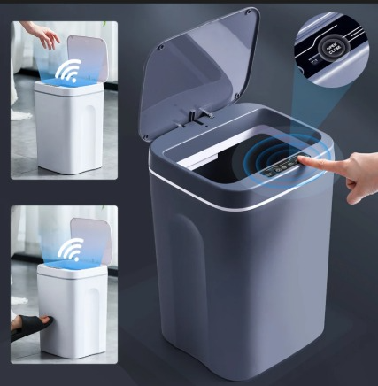
PROPOSED SOLUTION
The Smart Assistive Dustbin ensures hygienic, efficient waste handling with touchless lid operation, fill-level monitoring, and autonomous navigation via line-following sensors. A servo-driven mechanism enables automatic emptying, while an ESP32 controls functions and displays status on an LCD or app. Combining automation, mobility, and intelligence, it offers a modern, sustainable solution to today’s waste management challenges.

Slide 4
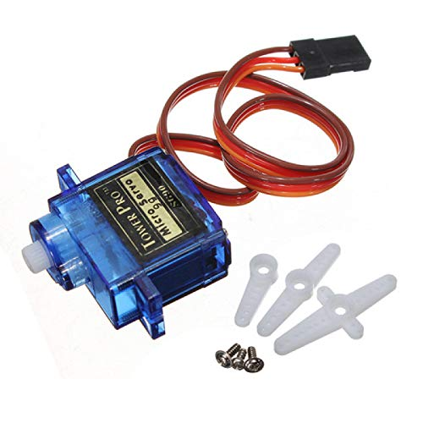
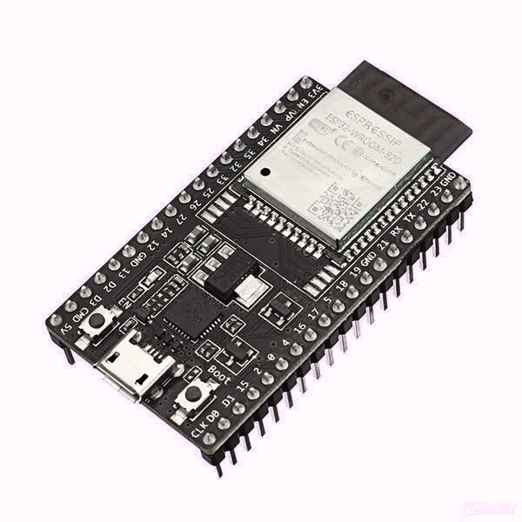
TECHNICAL APPROACH
Tools & Components
Controller: ESP32
Sensors: IR (lid + navigation), Ultrasonic (fill level)
Actuators: Servo motors (lid + tilting), DC motors (mobility)
Power: Li-ion battery with regulator
Output: LCD / Mobile App
Software: Arduino IDE (C/C++), IoT via Blynk/MQTT

Slide 5
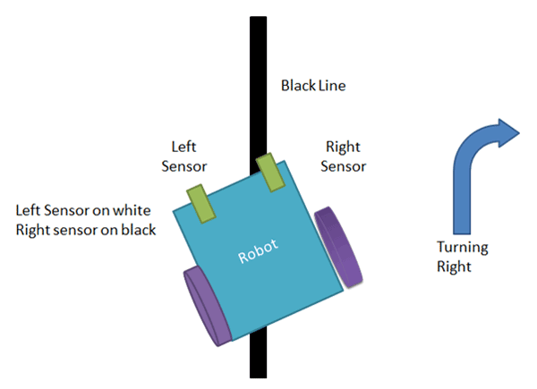
TECHNICAL APPROACH
Workflow
IR sensor detects hand → Servo opens lid (touchless).
Ultrasonic sensor monitors waste fill level.
IR floor sensors guide line-following navigation.
Servo tilts bin to empty waste, then resets.
Bin docks for recharge/maintenance.
Status displayed on LCD/app.

Slide 6
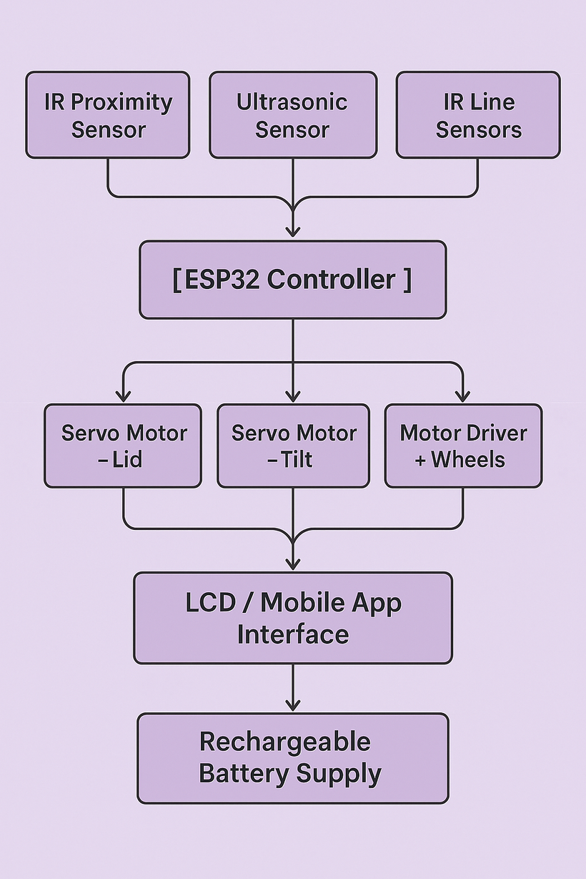
TECHNICAL APPROACH
ARCHITECTURE DIAGRAM

Slide 7
TECHNICAL APPROACH
IMPLEMENTATION
•HARDWARE: ESP32, HC-SR04, IR SENSORS, SERVO/DC MOTORS, L298N DRIVER, LI-ION BATTERY, LCD.
•SOFTWARE: ARDUINO IDE (C/C++), IOT DASHBOARD (BLYNK/MQTT).

Slide 8
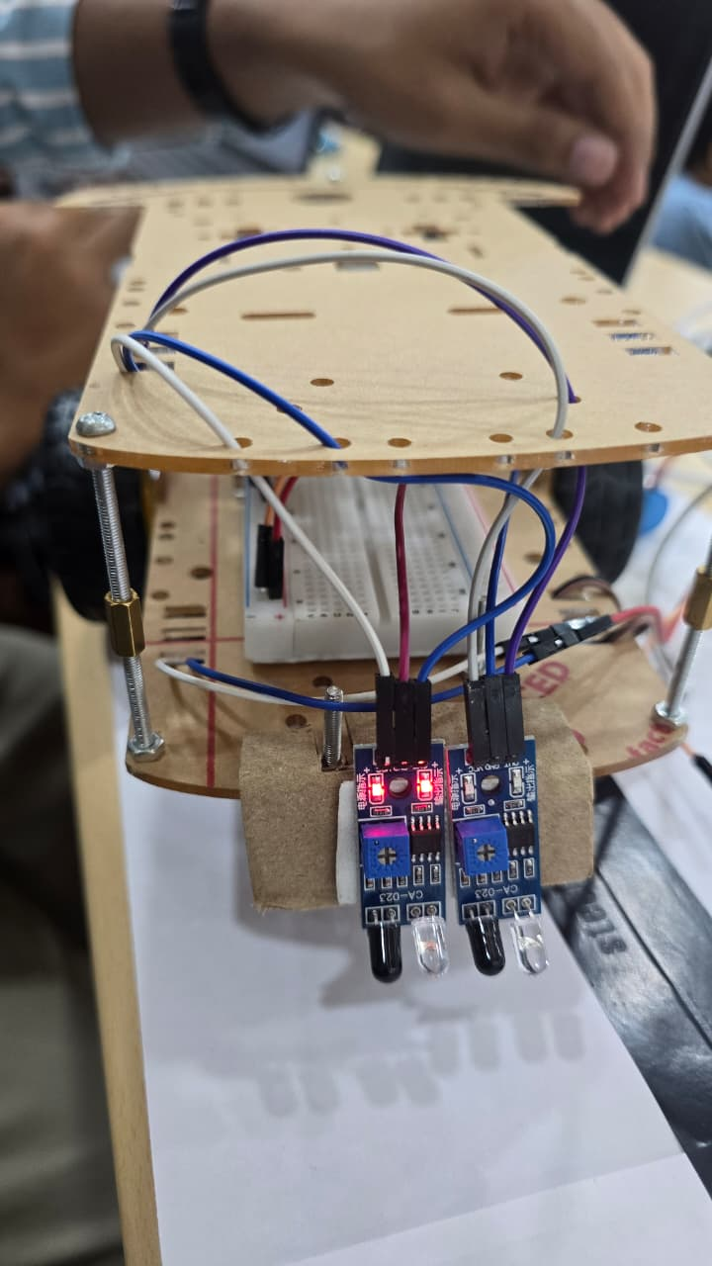
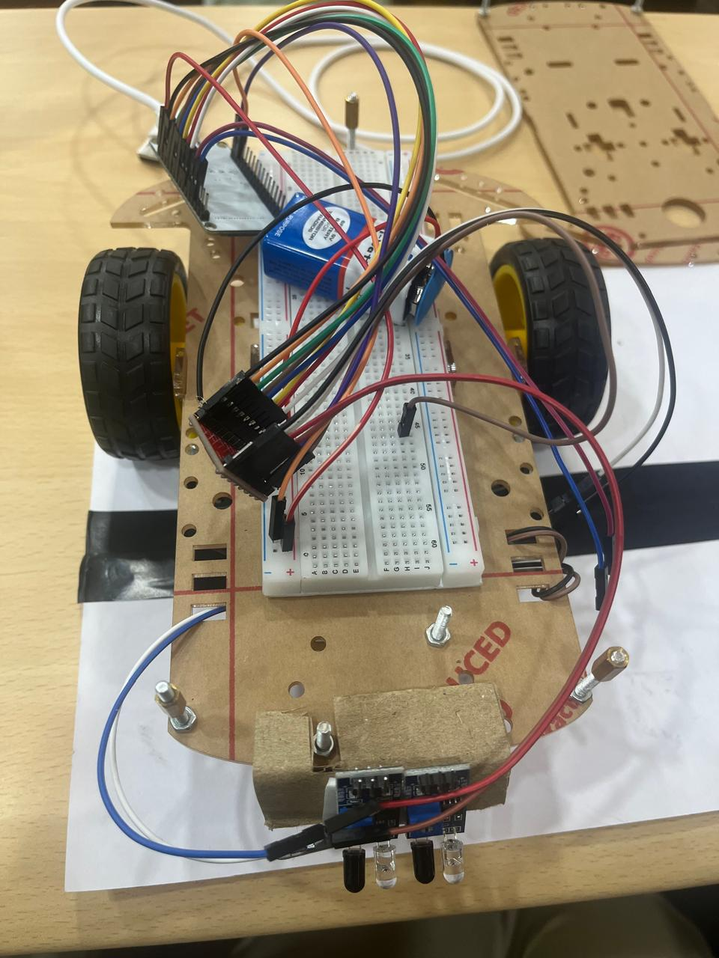
DEMO

Slide 9
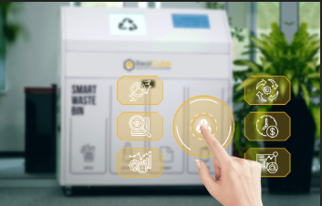
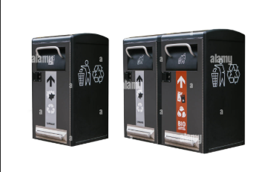
IMPACT & USE CASES
Households, schools, hospitals, offices, malls, airports, and public spaces benefit from the solution.
Facility managers and municipal corporations can use it for smarter operations.
Provides touchless, hygienic waste disposal to reduce health risks.
Prevents foul odors, pest infestation, and contamination.
IoT-enabled monitoring helps optimize collection schedules and logistics.
Can be deployed in smart-city waste networks.
Reduces operational costs and improves efficiency.
Contributes to cleaner, healthier, and more sustainable urban environments.

Slide 10

CHALLENGES FACED & HOW YOU OVERCAME THEM
HARDWARE INTEGRATION
CHALLENGE: Multiple components (motors, servos, IR sensors, ultrasonic) caused wiring conflicts & unstable power supply.
SOLUTION: Used proper pin mapping, motor driver (tb6612fng), and regulated power to ensure stable operation.
ULTRASONIC FILL DETECTION
CHALLENGE: Ultrasonic sensor gave unstable readings inside the dustbin.
SOLUTION: Used averaging of multiple readings + mapped values to a fixed range for stable fill-level percentage.

Slide 11
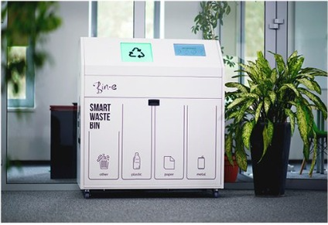
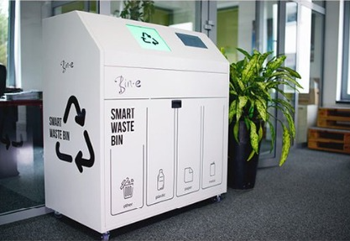
FUTURE SCOPE
Smarter Waste Management
•Add AI/Camera-based recognition to automatically classify recyclable vs. non-recyclable waste.
•Enable real-time data sharing with municipalities for predictive waste collection.
Better Connectivity
•Add Wi-Fi modules so bins send fill-status directly to waste collection systems.
•Integrate into Smart City dashboards for route optimization.
Improved Hardware
•Use rechargeable battery with solar charging → fully sustainable operation.
•Add stronger, compact motors for smoother movement & better load handling.

Slide 12
CONCLUSION
The smart assistive dustbin transforms traditional waste bins into “intelligent helpers,” using sensors and IoT like a brain and nervous system to ensure touchless, hygienic, and efficient waste disposal.
Its autonomous mobility and self-emptying design act like a “self-driving vehicle for waste,” reducing human effort, labor costs, and health risks.
The project stands out by combining automation, sustainability, and practicality into a single, scalable solution that aligns with modern urban needs, making waste management smarter and safer.

Slide 13
ACKNOWLEDGEMENTS
We sincerely thank the organizers of InnovAct 2025 for providing us with the platform
for providing us with the opportunity and resources to work on this project.
We would like to acknowledge the efforts of our team members whose dedication, creativity, and collaboration made this project possible.
We also acknowledge the open-source developer community whose libraries, frameworks, and documentation enabled rapid prototyping.

Slide 14
Thank You

